Slide 1
TEXT SUMMARIZATION
USING TRANSFORMERS
J. Abhay - 20J41A6724
S. Sai Bhargav - 20J41A6751
S. Muralidhar - 20J41A6752
LC. Yogeshwar Vijay Puri - 21J45A6704

Slide 2
PROBLEM STATEMENT
In the era of information overload, the need for efficient text summarization techniques has become paramount.
Traditional methods often fall short in capturing the nuances and contextual understanding required for generating concise and informative summaries.
This project aims to develop a robust and effective text summarization system utilizing Transformer-based architectures.
The objective is to create a model that can accurately distill lengthy textual content into succinct summaries while preserving the core message and salient details.

Slide 3
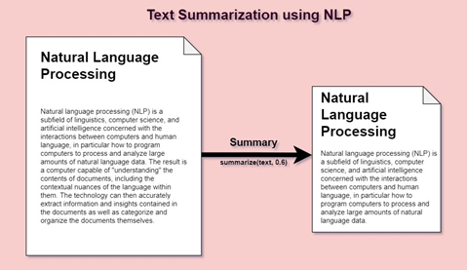
INTRODUCTION
Text summarization is the creation of a short, accurate, and fluent summary of a longer text document. It is the practice of breaking down long publications into manageable paragraphs or sentences. The procedure extracts important information while also ensuring that the paragraph's sense is preserved.

Slide 4
THESE ARE THE
PROJECTIONS!
350ZB
IN 2030
90ZB
IN 2021
1.7ZB
IN 2000

Slide 5
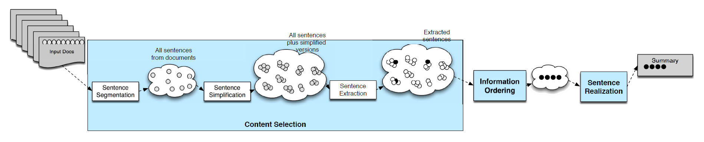
STAGES IN SUMMARIZATION

Slide 6
EXTRACTIVE SUMMARIZATION
Extractive summarization selects a subset of sentences from the text to form a summary.
Sentence Selection
Scoring and Ranking
Thresholding
Sentence Ordering
ABSTRACTIVE SUMMARIZATION
Abstractive summarization reorganizes
the sentences and adds novel
words/phrases into the summary if
necessary.
Understanding Concept
Paraphrasing and Rewriting
Sentence Generation
Quality Assessment
TYPES OF SUMMARIZATION

Slide 7
EXAMPLE
Peter and Elizabeth took a taxi to attend the night party in the city. While in the party, Elizabeth collapsed and was rushed to the hospital.
ABSTRACTIVE
Elizabeth was hospitalized after attending a party with Peter.
EXTRACTIVE
Peter and Elizabeth attend party city. Elizabeth rushed hospital.

Slide 8
WHAT IS TOKENIZATION
Tokenization is the process of breaking up a given text into units called tokens. These tokens are very useful for finding patterns as well as is considered as a base step for Stemming and Lemmatization.
Example:
Input Text: "Tokenization is an important NLP technique."
Tokenized Output: ["Tokenization", "is", "an", "important", "NLP", "technique", "."]

Slide 9
Previously Proposed Methodology:
Limitations:
Long sentences
Multi-tasking
Ambiguity
Transfer Learning
Paraphrasing abilities
Multimodal Summarization
Before the advent of Transformer models, traditional methods for tasks like language understanding relied on Recurrent Neural Networks (RNNs), Long Short-Term Memory networks (LSTMs), and Convolutional Neural Networks (CNNs). These methods, while effective to some extent, had several limitations.

Slide 10
LIBRARIES USED
Streamlit
Openai
Transformers
T5Tokenizer, TFT5ForConditionalGeneration
GPT2Tokenizer, TFGPT2LMHeadModel
PegasusTokenizer, TFPegasusForConditionalGeneration
BartTokenizer, TFBartForConditionalGenerationStreamlit

Slide 11
MODELS USED
T5 (Text-to-Text Transfer Transformer)
GPT-3 (Generative Pre-trained Transformer 3)
PEGASUS
BART (Bidirectional and Auto-Regressive Transformers)

Slide 12
APPLICATIONS
Media Monitoring
Newsletters
Financial Research
Social media Marketing
Medical cases
Email overload
Programming Languages

Slide 13
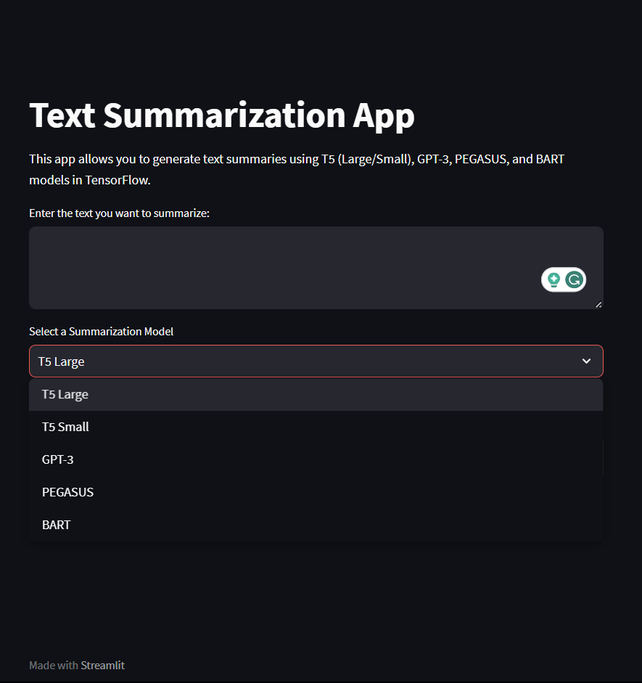
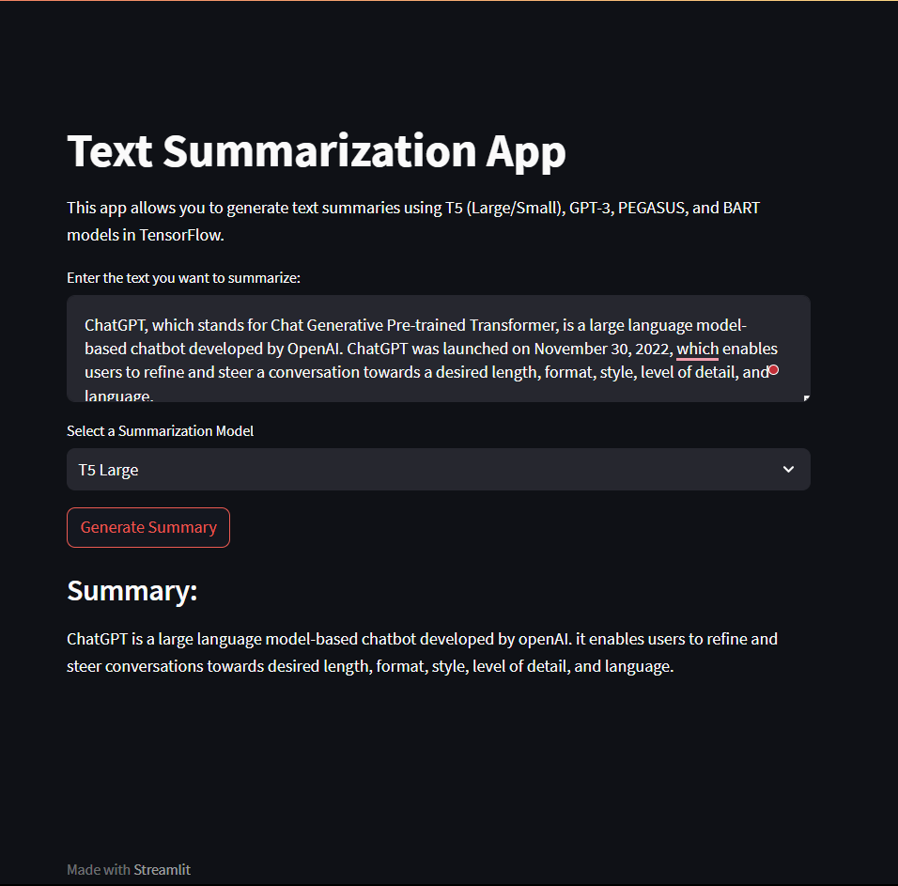

Slide 14
THANK YOU

